Slide 1
Layer 3 vulnerabilities IPSec and VPN
Tirthankar Ghosh

Slide 2
Why Security at Network Layer?
Application independent
Single solution for protecting data from all applications

Slide 3
IPSec
RFC 1636 (1994) identified security need
encryption and authentication necessary security features in IPv6
designed also for use with current IPv4
Notes:
In 1994, the Internet Architecture Board (IAB) issued a report titled "Security in the Internet Architecture" (RFC 1636). The report stated the general consensus that the Internet needs more and better security and identified key areas for security mechanisms. Among these were the need to secure the network infrastructure from unauthorized monitoring and control of network traffic and the need to secure end-user-to-end-user traffic using authentication and encryption mechanisms.
To provide security, the IAB included authentication and encryption as necessary security features in the next-generation IP, which has been issued as IPv6. Fortunately, these security capabilities were designed to be usable both with the current IPv4 and the future IPv6. This means that vendors can begin offering these features now, and many vendors do now have some IPsec capability in their products. The IPsec specification now exists as a set of Internet standards.
IPsec provides the capability to secure communications across a LAN, across private and public WANs, and across the Internet. Examples of its use include:
Secure branch office connectivity over the Internet: A company can build a secure virtual private network over the Internet or over a public WAN. This enables a business to rely heavily on the Internet and reduce its need for private networks, saving costs and network management overhead.
Secure remote access over the Internet: An end user whose system is equipped with IP security protocols can make a local call to an Internet service provider (ISP) and gain secure access to a company network. This reduces the cost of toll charges for traveling employees and telecommuters.
Establishing extranet and intranet connectivity with partners: IPsec can be used to secure communication with other organizations, ensuring authentication and confidentiality and providing a key exchange mechanism.
Enhancing electronic commerce security: Even though some Web and electronic commerce applications have built-in security protocols, the use of IPsec enhances that security. IPsec guarantees that all traffic designated by the network administrator is both encrypted and authenticated, adding an additional layer of security to whatever is provided at the application layer.

Slide 4
IPSec (cont’d)
Can provide protection in any combination of:
Confidentiality
Integrity
Authentication
Replay protection
Traffic analysis protection
Access control

Slide 5
Benefits of IPsec
provides strong security for external traffic
below transport layer hence transparent to applications
can be transparent to end users
can provide security for individual users if needed
Notes:
When IPsec is implemented in a firewall or router, it provides strong security that can be applied to all traffic crossing the perimeter. Traffic within a company or workgroup does not incur the overhead of security-related processing.
IPsec in a firewall is resistant to bypass if all traffic from the outside must use IP and the firewall is the only means of entrance from the Internet into the organization.
IPsec is below the transport layer (TCP, UDP) and so is transparent to applications. There is no need to change software on a user or server system when IPsec is implemented in the firewall or router. Even if IPsec is implemented in end systems, upper-layer software, including applications, is not affected.
IPsec can be transparent to end users. There is no need to train users on security mechanisms, issue keying material on a per-user basis, or revoke keying material when users leave the organization.
IPsec can provide security for individual users if needed. This is useful for offsite workers and for setting up a secure virtual subnetwork within an organization for sensitive applications.

Slide 6
Virtual Private Network (VPN)
set of computers interconnected using an unsecure network
e.g. linking corporate LANs over Internet
using encryption & special protocols
to provide security
eavesdropping
entry point for unauthorized users
proprietary solutions are problematic
development of IPSec standard
Notes:
In today's distributed computing environment, the virtual private network (VPN) offers an attractive solution to network managers. In essence, a VPN consists of a set of computers that interconnect by means of a relatively unsecure network and that make use of encryption and special protocols to provide security. At each corporate site, workstations, servers, and databases are linked by one or more local area networks (LANs). The LANs are under the control of the network manager and can be configured and tuned for cost-effective performance. The Internet or some other public network can be used to interconnect sites, providing a cost savings over the use of a private network and offloading the wide area network management task to the public network provider. That same public network provides an access path for telecommuters and other mobile employees to log on to corporate systems from remote sites.
But the manager faces a fundamental requirement: security. Use of a public network exposes corporate traffic to eavesdropping and provides an entry point for unauthorized users. To counter this problem, the manager may choose from a variety of encryption and authentication packages and products. Proprietary solutions raise a number of problems. First, how secure is the solution? If proprietary encryption or authentication schemes are used, there may be little reassurance in the technical literature as to the level of security provided. Second is the question of compatibility. No manager wants to be limited in the choice of workstations, servers, routers, firewalls, and so on by a need for compatibility with the security facility. This is the motivation for the IP Security (IPsec) set of Internet standards.

Slide 7
VPN Architecture
Gateway to gateway
Host to gateway
Host to host

Slide 8
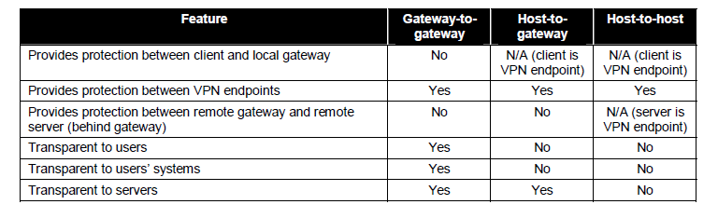
Comparison Between VPN Architectures
Courtesy: NIST

Slide 9
IPSec Functions
Authentication Header (AH)
Encapsulation Security Payload (ESP)
Key distribution

Slide 10
AH Modes
Tunnel mode: Creates a new IP header for each packet
Transport mode: Uses the original IP header

Slide 11


AH Modes (cont’d)
Tunnel mode header
Transport mode header
Courtesy: NIST

Slide 12
Integrity Protection
Creates a hash using a keyed hash algorithm, called Message Authentication Code (MAC) algorithm
The message, along with the keyed hash, is sent to the recipient
The recipient verifies the hash
Provides integrity protection
Integrity protection cannot be done on the mutable field of the IP header
Conflicts with NAT

Slide 13

Authentication Header
Courtesy: NIST

Slide 14
Authentication Header (cont’d)
Next header: points to the next packet payload. For tunnel header, points to IPv4; for transport header, points to transport layer header
Payload length: contains length of the payload in 4 bytes increment
Security parameter index (SPI): unique id for the connection, value chosen at random
Sequence number: each packet is assigned a sequence number, used in a sequential order. Protects against packet replay, and DoS attack
Authentication information: output of the hashed MAC

Slide 15
Packet Dump of AH
Refer to document in NIST publication

Slide 16
Encapsulation Security Payload (ESP)
Earlier version of ESP only provides encryption
Later versions can provide authentication also
Encryption can be disabled using Null ESP Encryption Algorithm
Two modes:
Tunnel mode
Transport mode

Slide 17
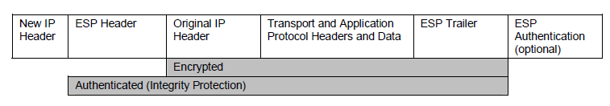
ESP Tunnel Mode
Creates new IP header for each packet
Can be used with all three VPN architectures
Can be used to encrypt and/or authenticate the data as well as original IP header
Courtesy: NIST

Slide 18
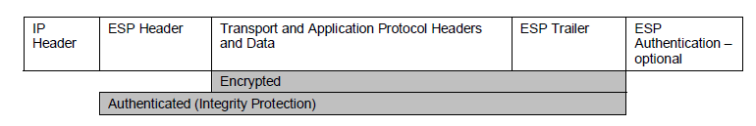
ESP Transport Mode
Uses the original IP header instead of creating a new one
Cannot provide encryption and/or authentication for the original IP header
Generally used for host to host architecture
Incompatible with NAT
Courtesy: NIST

Slide 19
Encryption
Uses symmetric cryptography
Uses Cipher Block algorithms, like AES-CBC (Cipher Block Chaining), 3-DES, or AES-CTR (Counter mode)

Slide 20
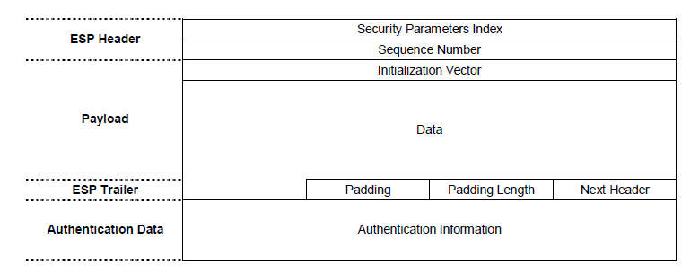
ESP Packet Structure
Courtesy: NIST

Slide 21
ESP Packet Header
Security parameter index (SPI): unique id for the connection, value chosen at random
Sequence number: each packet is assigned a sequence number, used in a sequential order. Protects against packet replay, and DoS attack

Slide 22
ESP Packet Header (cont’d)
Payload: encrypted payload, and unencrypted Initialization Vector (IV)

Slide 23
ESP Packet Trailer
Padding: used for block cipher chaining; also used to ensure that the trailer ends in 4-bytes blocks
Padding length: indicates length of padding used
Next header: points to the next packet payload. For tunnel header, points to IPv4; for transport header, points to transport layer header

Slide 24
Internet Key Exchange (IKE)
Generally used to negotiate and manage security associations
In IPSec, IKE is used to provide a secure mechanism to establish an IPSec-protected connection
Five types of IKE exchanges:
Main mode
Aggressive mode
Quick mode
Informational mode
Group mode

Slide 25
IKE Phase I Exchange
Used to establish an IPSec secure channel (IKE SA)
IKE SA is used to establish bidirectional encryption and authentication
IKE SA can be established by:
Main mode
Aggressive mode

Slide 26
Main Mode IKE SA
Uses three pairs of messages to establish IKE SA
The first pair uses the following parameters:
Encryption algorithm
Integrity protection algorithm
Authentication method
Diffie-Hellman group

Slide 27
Main Mode IKE SA (cont’d)
Second pair of messages is used to exchange keys using Diffie-Hellman using parameters negotiated in the first phase
The third pair of messages is used to authenticate each end user to the other; depends on the negotiated authentication method

Slide 28
Aggressive Mode IKE SA
IKE SA is established using three messages
First two messages negotiate parameters and perform key exchange
Second and third messages authenticate the hosts

Slide 29
IKE Phase II Exchange
Purpose is to establish an IPSec SA
Unidirectional, i.e., requires two security associations
Uses quick mode using three messages
In the first message, endpoint A sends keys, nonces, and IPsec SA parameter suggestions.
In the second message, endpoint B sends keys, nonces, and IPsec SA parameter selections, plus a hash for authentication.
In the third message, endpoint A sends a hash for authentication.

